Slide 1
Practical Aspects of SRF Cavity Testing and Operations
Tom Powers
SRF Workshop 2011
Tutorial Session

Slide 2
PRACTICAL ASPECTS OF OPERATION
Interlocks
Optimizing Loaded-Q
Pulsed response as a function of loaded-Q
Multiple cavities driven by a single source

Slide 3
CRYOMODULE INTERLOCKS
NEVER OPERATE A CRYOMODULE WITH THE COUPLER INTERLOCKS BYPASSED
Coupler Interlocks
Arc detector(s)
Coupler vacuum
Window temperature
Water flow (If water cooled)
Electron probe (Useful but not required)
Water temperature (Useful but not required)
Cryomodule
Cavity vacuum
Helium level
Helium pressure (Useful but not required depending on cryo plant)
Insulating vacuum (Useful but not required)
RF Driven Interlocks
Quench detection
E²/P_{FWD} ratio
Gradient Present with RF off

Slide 4
OPTIMIZING LOADED-Q
Where
δf is the frequency shift of the cavity from the generator frequency
ψ_{B} is the phase of the resultant* beam relative to cavity gradient and
β = (Q₀ – Q_{L}) / Q_{L}
You need to take the derivative of this equation with respect to Q_{L} in order to calculate the minimum klystron power necessary.
* Note: For an multiple beams at once, i.e. an energy recovered linac (ERL), the resultant beam current is the vector sum of the beams

Slide 5
MODERATE AMOUNT OF MATH

Slide 6
REDUCED SOLUTION FOR SRF CAVITIES OPERATED ON CREST
But life is never perfect

Slide 7
THE EFFECTS OF TUNING ON OFF CREST CW BEAM LOADING
On beam turn on the forward power increases the phase shifts and microphonics effects are multiplied
The tuner operates with a goal of making ψ_{Kly} equal to zero by shifting the frequency by δf_{S} which compensates for the I₀R_{C}sinψ_{B} term.
Thus ψ_{Kly} → 0 and P_{Kly} is minimized to:
0
Where δf_{M} is the frequency shifts due to microphonics
Thus in this case:

Slide 8
THEORETICAL EXAMPLE OF TUNERS COMPENSATING FOR OFF CREST BEAM LOADING
CEBAF 7-Cell Cavity
L = 0.7 m
(r/Q) = 960
E = 8 MV/m
Q_{L} = 2 x 10⁷
δf = 10 Hz
I₀ = 10 mA
Pass one ψ_{B} = -10º
Pass two ψ_{B} = 166º
Resultant Beam
0.7 mA at 78°

Slide 9
THEORETICAL EXAMPLE OF TUNERS COMPENSATING FOR OFF CREST BEAM LOADING

Slide 10
PREDICTED AND MEASURED FORWARD POWER IN AN ERL
The solid lines indicate the predicted values based on:
Q_{L} = 2 x 10⁷
E = 5.6 MV/m.
Δf = 10 Hz
Test Process:
Tune the cavity with no current.
Disable the mechanical tuners.
Ramp the current up and record the forward power and phase.
Repeat with Tuners enabled.

Slide 11
Predicted and Measured RF Drive Phase In an ERL

Slide 12
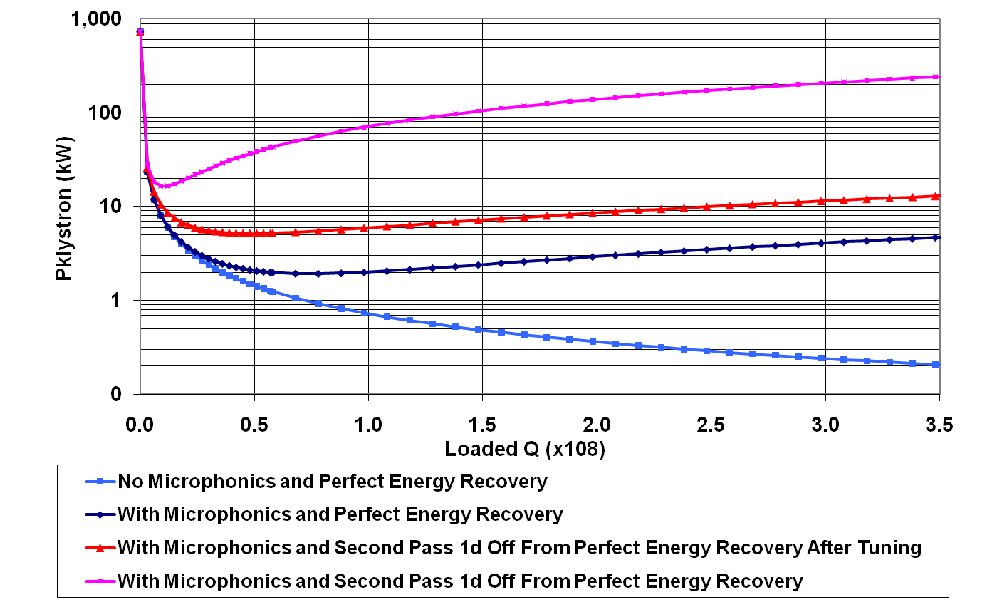
EFFECTS OF MICROPHONICS AND IMPERFECT ENERGY RECOVERY IN AN ERL CAVITY E = 20 MV/m, I₀ = 100 mA

Slide 13
SELECTING LOADED-Q FOR OFF CREST BEAM
Selection of loaded-Q has implications on RF power requirements.
When the beam is operated on crest the process is straight forward and margins only have to be added for
Microphonics,
Uncertainties in cavity parameters such as Q_{L} and operating gradient.
Overall Margin
Detuning effects.
When the beam is not operated on crest operational modes must be considered. Often this can substantially reduce the RF power requirements.
Ramping current simultaneous with operating tuners.
Allowed levels of pulsed operation
Uncertainty of the relative beam phases in an ERL

Slide 14
MULTIPLE CAVITIES ON SINGLE SOURCE
It can be a desirable to use a single source to drive multiple cavities.
Reduced cost per Watt at higher RF –Power levels.
Availability of klystrons or IOTs at desired levels for multiple cavities.
Unavailability of klystrons, IOTs at desired power levels for single cavities.
Reduced number of LLRF systems to drive cavities.

Slide 15
MULTIPLE CAVITIES ON SINGLE SOURCE
It can work fine when:
The cavities are operated near crest.
The beam is not sensitive to minor variations in gradient and phase.
Loaded-Qs are well matched.
Gradients are close to the same for all cavities.
The loaded-Qs are relatively low as compared to pressure sensitivity and microphonics.
You have the advantage of a large number of cavities and individual errors are corrected by statistics.
It can present problems when:
The beam is sensitive to errors in gradients or phase.
Detuning becomes significant as compared to the FPC bandwidths.
Cavities are operated at different gradients.
Cavities have different loaded-Qs
Cavities are operated at different beam phases with respect to crest.
While linacs are an area where this concept can be very practical, injectors are an area where the problems become important especially when space charge and cavity induced beam focusing are important.

Slide 16
SIMULATION METHOD
Use the basic complex RF voltage to complex gradient equation to calculate the field in each cavity, including beam phase and cavity detune angle.
Sum the real and imaginary parts of the electric field.
Compare the vector sum to the desired vector sum and calculate the error in the vector sum.
Add, with gain, the complex error to the complex RF voltage from the current pass.
Use this sum to calculate gradient in each cavity.
Repeat until the real and imaginary parts of the vector sum error are below a threshold.
Where ψ is the cavity detune angle.

Slide 17
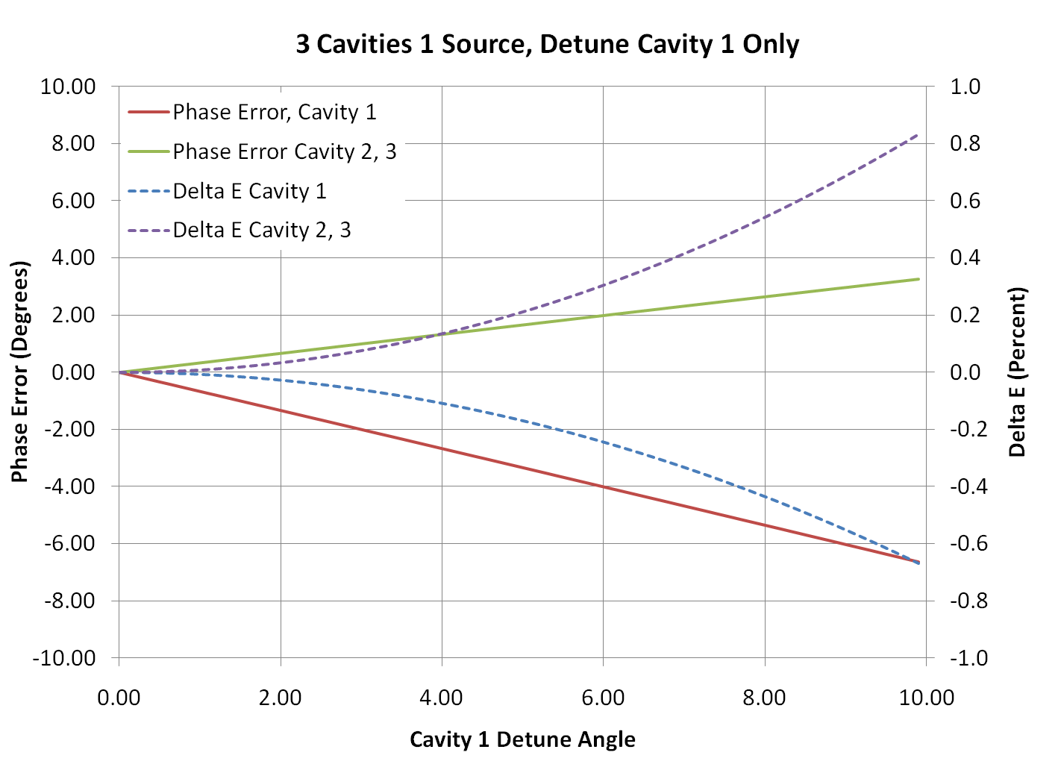
ERROR IN GRADIENT AND PHASE WHEN 1 OF 3 CAVITIES IS DETUNED
Q_{L} = 2e6
F₀ = 1497 MHz
(r/Q) = 960 Ω/m
L = 0.5 m
β = 3000

Slide 18
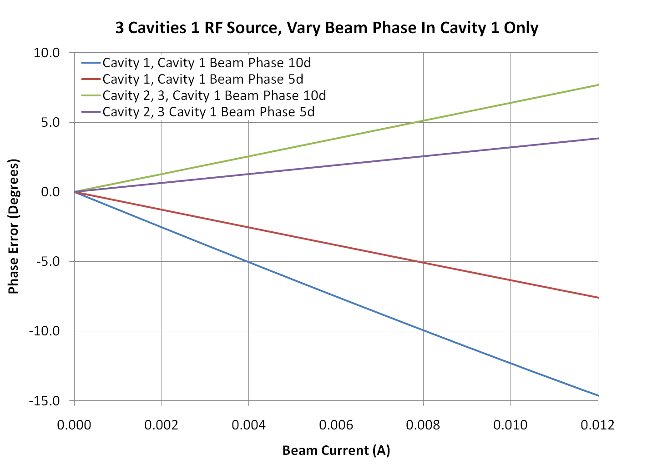
PHASE ERROR IN WHEN THE PHASE IN 1 OF 3 CAVITIES IS DIFFERENT

Slide 19
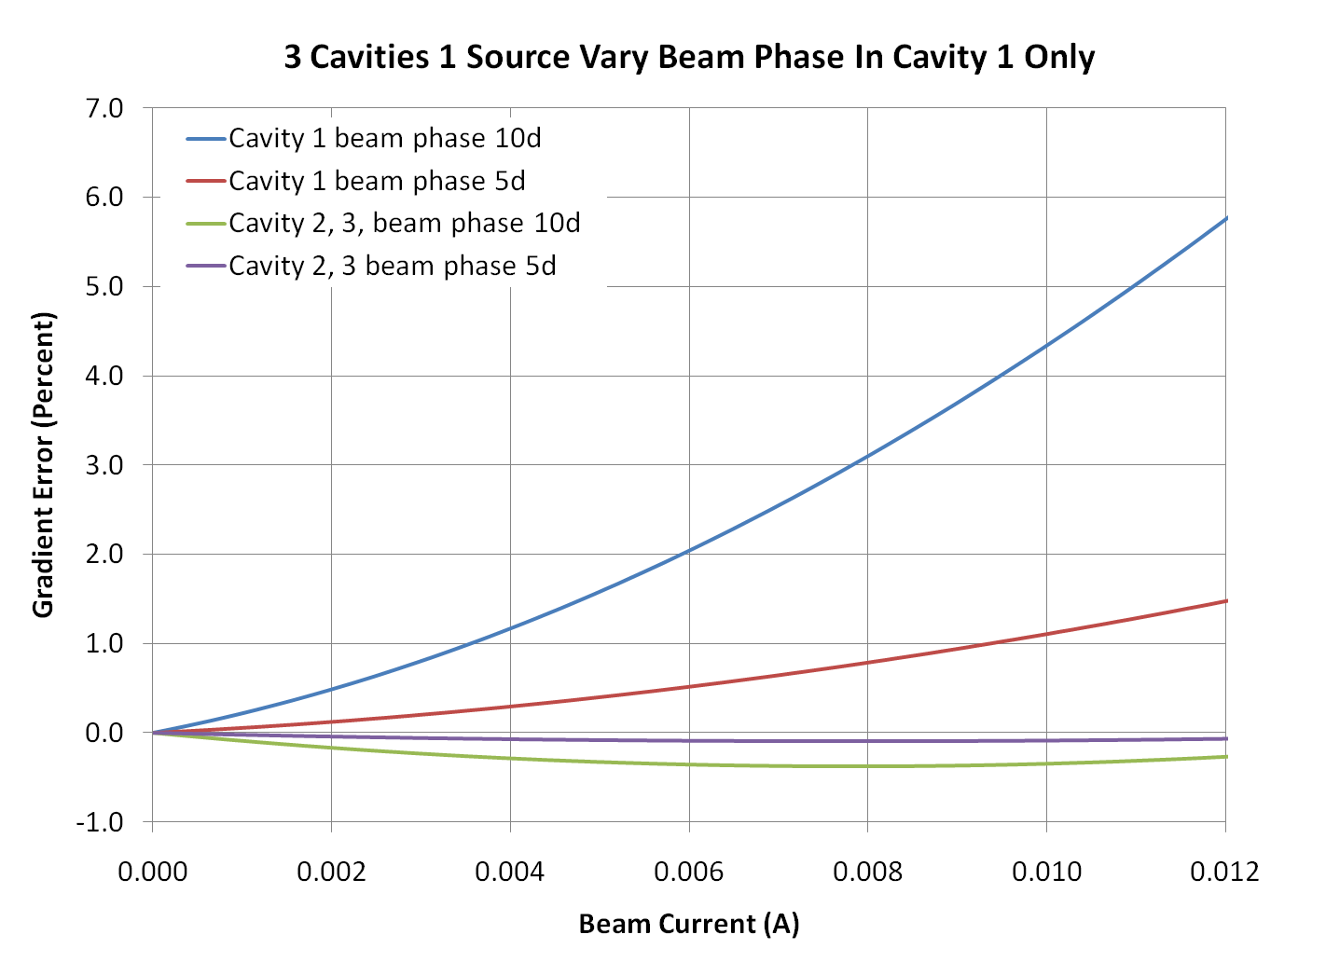
GRADIENT ERROR IN WHEN THE PHASE IN 1 OF 3 CAVITIES IS DIFFERENT

Slide 20
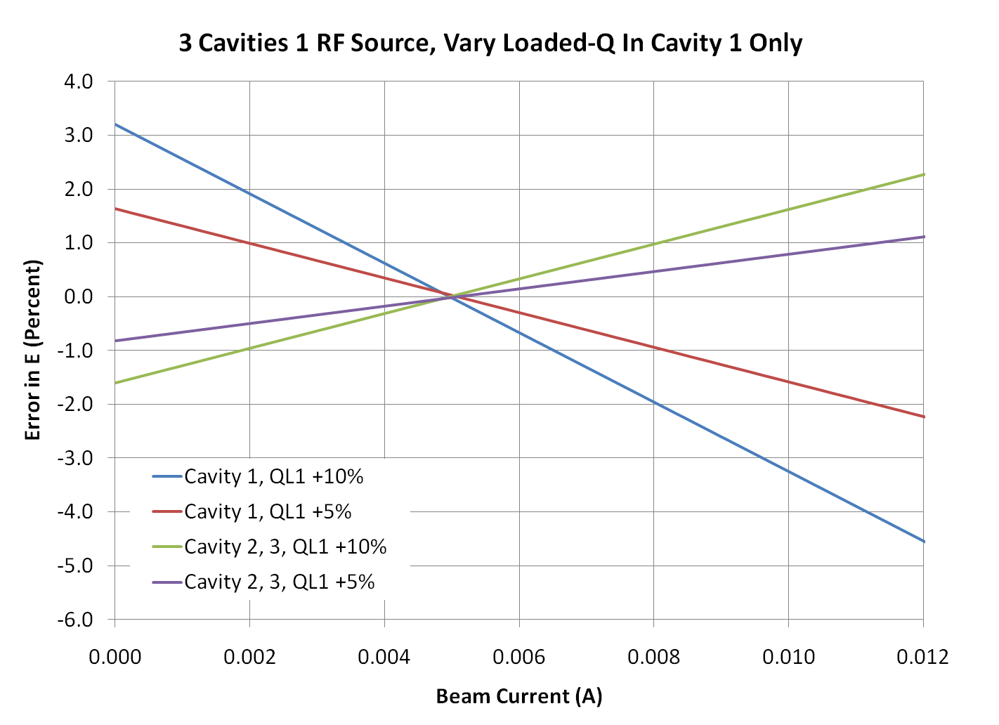
Gradient Error in When the Loaded-Q of 1 of 3 Cavities is Higher Than the Others

Slide 21
CONCLUSIONS
Thank you for your attention. I hope what I have presented will be useful.
Selected References.
Padamsee, Knobloch, and Hays, RF Superconductivity for Accelerators, John Wiley & Sons 1998.
T. Powers, “Theory and Practice of Cavity Test Systems” 2005 SRF Workshop. (Note: Includes all of the math for testing cavities)
T. Powers, “RF Controls Experience with the JLAB IR Upgrade FEL”, 2009 ERL Workshop.
J. Delayen, et. al., “Development of a Digital Self Excited Loop for Field Control in High-Q Superconducting Cavities, SRF 2007.
L. Merminga, “RF Cavity Equations Steady State”, JLAB Technical note TN-95-019.
K. Davis “Microphonics Testing of the CEBAF Upgrade 7-Cell Cavity”. PAC 2001.

